Slide 1

Recap – Do Now
$8−4c=−4$
$4\left(x−12\right)=6$
$\frac{3\left(x−6\right)}{4}=3$
$\frac{x}{6}−3=1$

Slide 2
Topic : Solving Equations
EQ – How do I solve equations with unknowns on both sides?

Slide 3
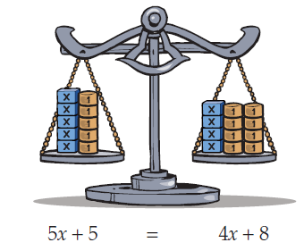

Solve $5x+5=4x+8$

Slide 4
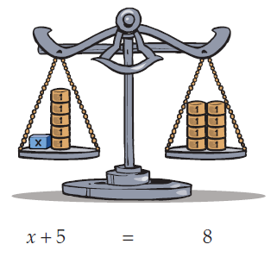
Solve $5x+5=4x+8$

Slide 5
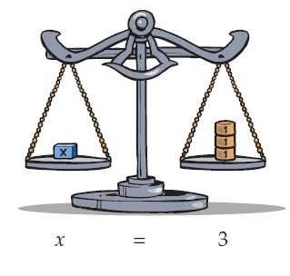
Solve $5x+5=4x+8$

Slide 6
Solving Equations – Recap
1) GOAL:
Get the variable on one side of the equation.
2) You always perform the same operation to both sides of an equation.
3) To undo an operation you perform its opposite operation to both sides of the equation.
4) Undo operations in the reverse order of BIMDAS

Slide 7
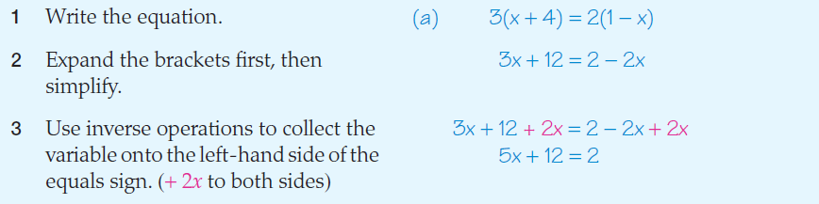
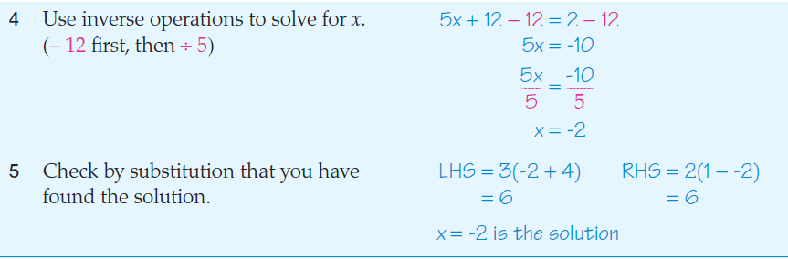
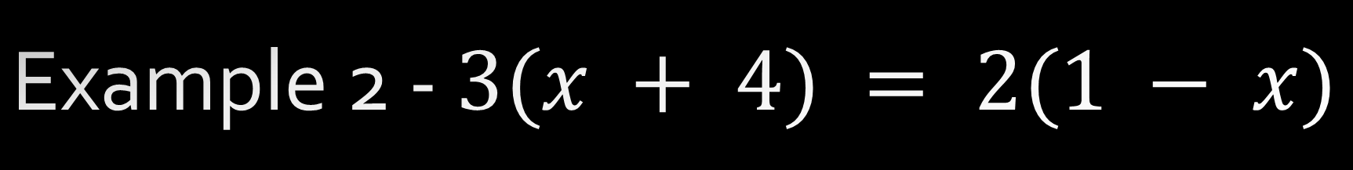
Example 2 - $3(x + 4) = 2(1 − x)$

Slide 8
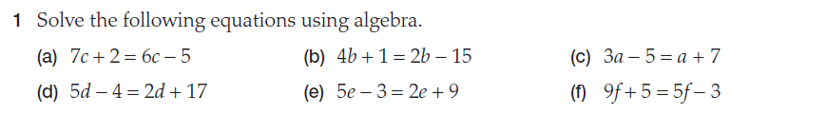
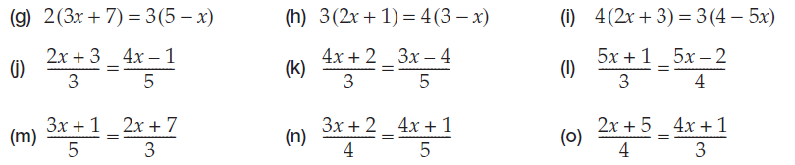
You Do

Slide 9
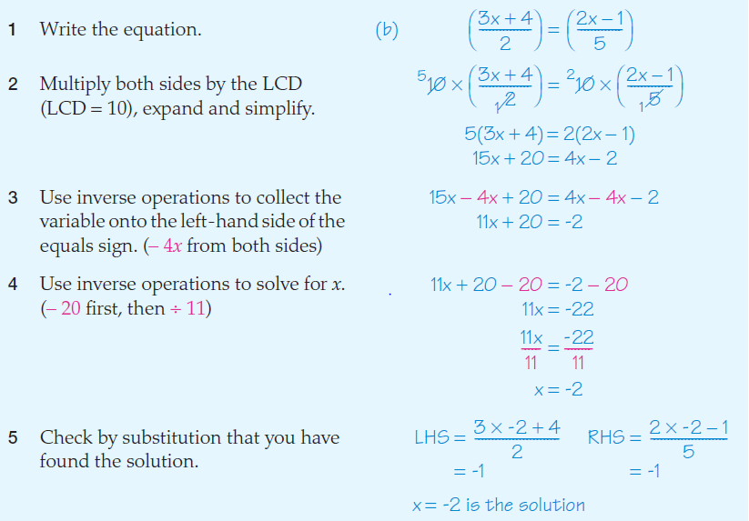

Example 3 : $\frac{3x+4}{2}=\frac{2x−1}{5}$
LCD = Lowest common denominator. This is the lowest common multiple of the two denominators.

Slide 10
You Do

